Slide 1

An Integrative Introduction
to Analyzing Data
Professor Harry Krashinsky
EMBA 46: QRM 2025

Slide 2
Recall our central mission in this course

Slide 3
Reinforcing Good, Penalizing Bad
Suppose
  Profits are up
  Productivity up
  defects down
  complaints are down
Suppose
  Profits are down
  Productivity down
  defects up
  complaints are up
Reinforce Behaviour that
contribute to these positive
outcomes
Penalize Behaviour that
contribute to these negative
outcomes

Slide 4
Identifying the Relevant Factors
How do you know which factors, or features of the production process, are contributing to the positive / negative outcomes?
We will utilize statistical procedures we learn here

Slide 5
And the Safety Chute
Sometimes, we’ll get into more technical points, but they may be more interesting to some of you (and less so for others).
At these points, I’ll continue to use our trusty picture:

Slide 6


Slide 7
The Importance and Usefulness of Averages

Slide 8
Averages
Up to this point, we’ve discussed averages in three different ways:
Simple averages
Regression coefficients (which, you’ll see, are averages, too)
Conditional means from regressions

Slide 9
(1) Simple Average
Calculating an average from a sample is about as direct a definition of “average” as we can get.
→A useful measure of “central tendency”

Slide 10
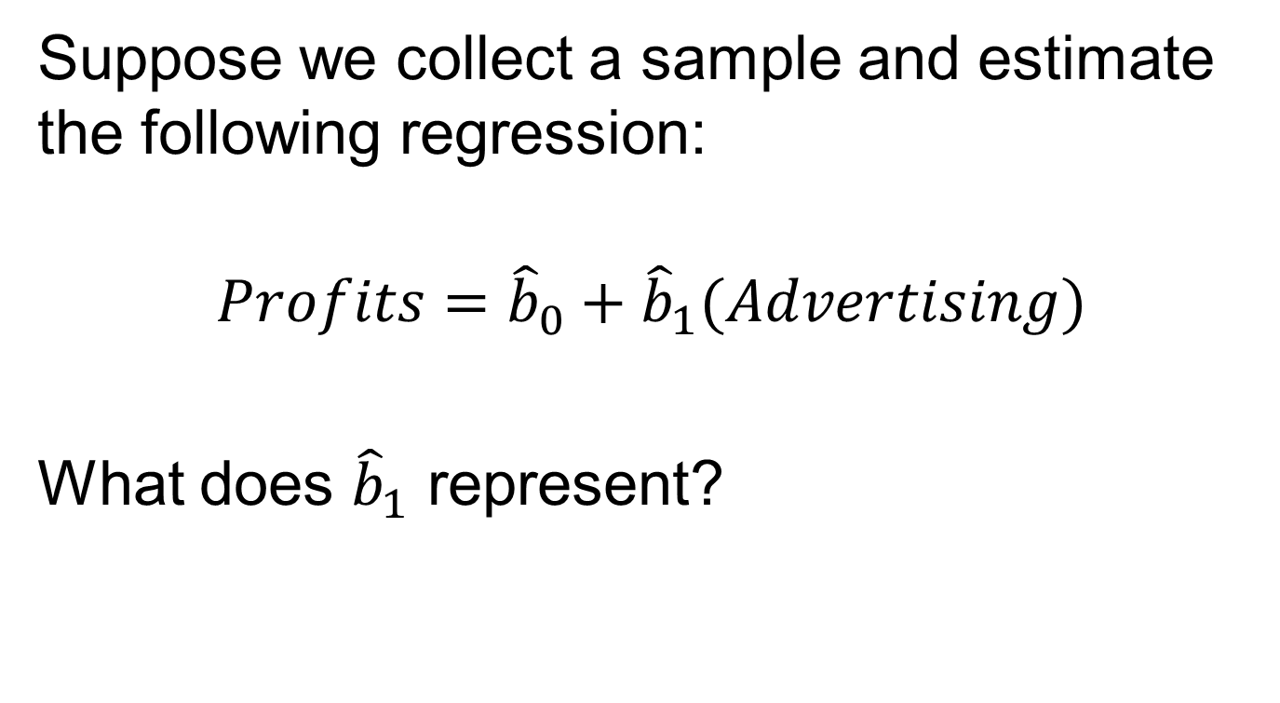
(2) Regression Coefficient
Suppose we collect a sample and estimate the following regression:
$$Profits={\hat{b}}_{0}+{\hat{b}}_{1}(Advertising)$$
What does ${\hat{b}}_{1}$ represent?

Slide 11
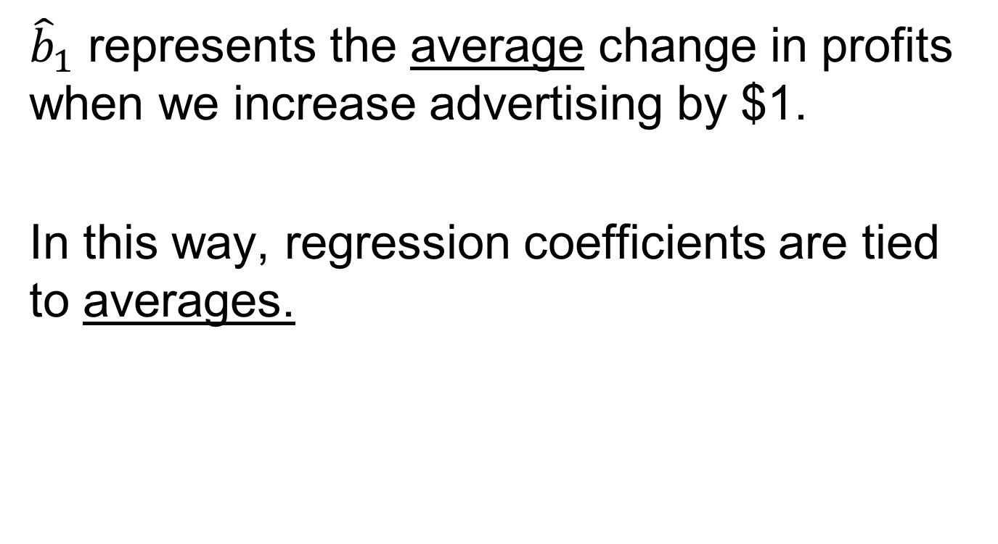
(2) Regression Coefficient
${\hat{b}}_{1}$ represents the average change in profits when we increase advertising by $1.
In this way, regression coefficients are tied to averages.

Slide 12
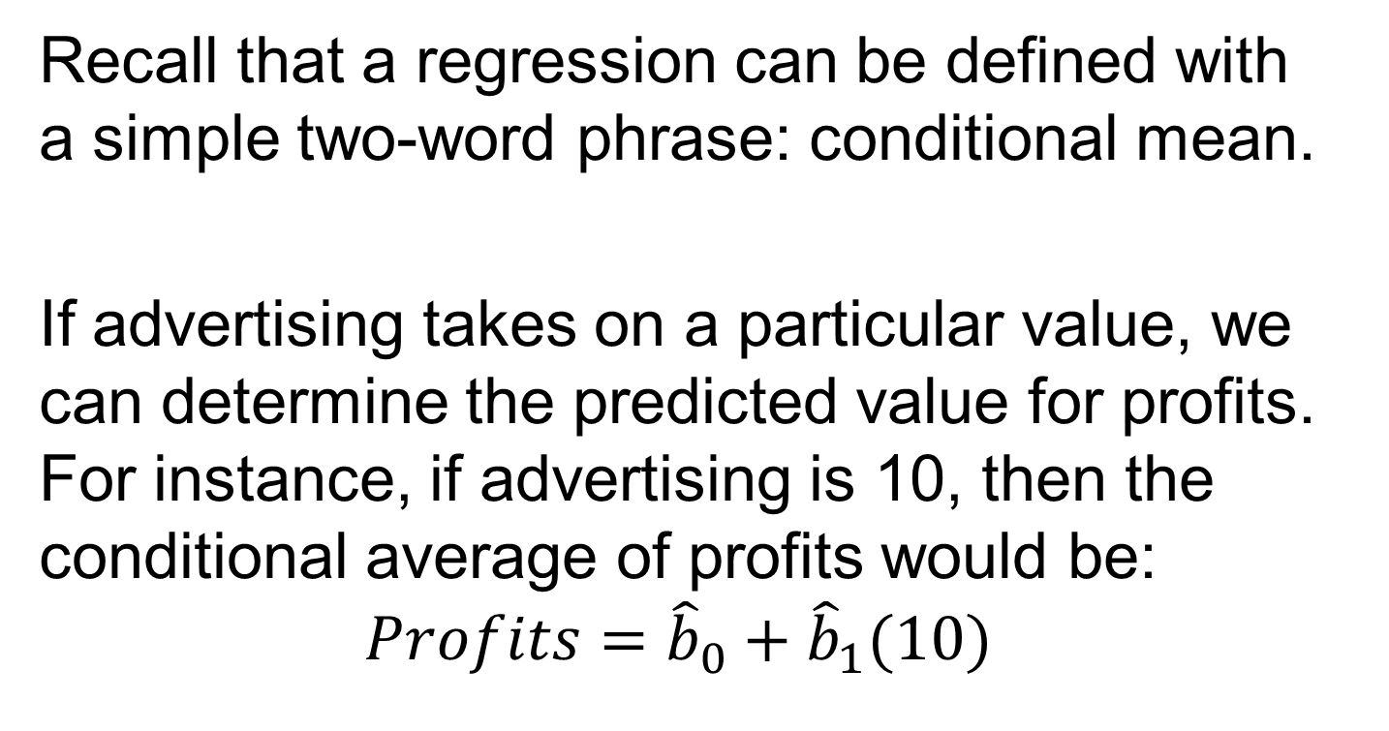
(3) Conditional Mean
Recall that a regression can be defined with a simple two-word phrase: conditional mean.
If advertising takes on a particular value, we can determine the predicted value for profits. For instance, if advertising is 10, then the conditional average of profits would be:
$$Profits={\hat{b}}_{0}+{\hat{b}}_{1}(10)$$

Slide 13
Key notions for Averages
Anytime we calculate an average, we’re making a guess about a characteristic of a population.
Keep the following picture in your mind as we cover material throughout our time together:

Slide 14
Population:
Too big to study
Sample:
Manageable
to study

Slide 15
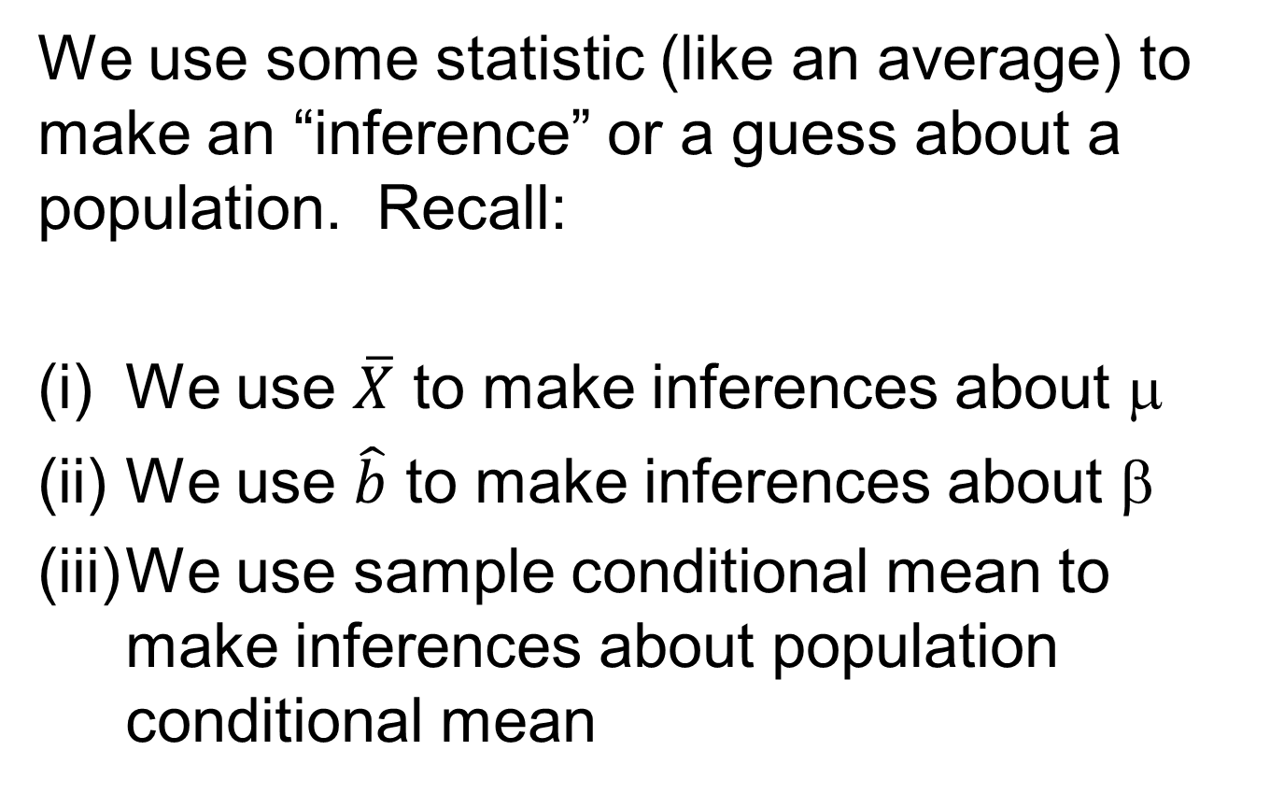
Purpose of using statistics
We use some statistic (like an average) to make an “inference” or a guess about a population. Recall:
We use $\overline{X}$ to make inferences about μ
We use $\hat{b}$ to make inferences about β
We use sample conditional mean to make inferences about population conditional mean

Slide 16
Purpose of using statistics
But we have key concerns about our guess:
(i) How good is our guess?
(ii) And guesses are inherently uncertain, so how do we describe the uncertainty that underlies the guess?

Slide 17
Central Limit Theorem
Anytime we compute a sample mean, we can rely on two things:
(1) The most likely value for our sample mean is the population mean
(2) A normal distribution underlies the way we use the sample mean to make a “guess” about the population mean.
This is due to a statistical notion called the “Central Limit Theorem”.

Slide 18
Central Limit Theorem
Key question: Why do sample averages follow a normal distribution?
Two ways to see this:
A mathematical proof. But it’s a little too challenging for the scope of our course.
A practical exercise

Slide 19
Central Limit Theorem
Let’s do an exercise that involves flipping coins:
Flip your coin 10 times
Count the number of times it comes up “heads”
Calculate the average number of times you got “heads” = (Number of “heads”)/10
Repeat (1)-(3) four times.

Slide 20
Central Limit Theorem
Quick questions:
(1) How many heads would we expect to throw?
→We’d expect 5 (if the coin is “fair”)
(2) What is the average we’d expect to compute?
→0.5 or 50%

Slide 21
Central Limit Theorem
BIG POINT: the population mean is 50% or 0.5 in this case.
Let’s see how our sample means came out around the population mean

Slide 22
Results

Slide 23
Central Limit Theorem
Now let’s suppose we were able to do this exercise thousands of times without becoming horribly impatient and/or getting Carpal-Tunnel in our thumbs.
With the assistance of my computer, here’s a series of histograms to show you what happens with an increasing number of averages computed

Slide 24
Central Limit Theorem

Slide 25
Central Limit Theorem

Slide 26
Central Limit Theorem

Slide 27
Central Limit Theorem

Slide 28
KEY OBSERVATION
The distribution of the sample mean gets progressively close to the normal distribution as our sample size grows
(Actually, it gets there very quickly)
And it’s centered around the population mean.

Slide 29
KEY OBSERVATION
That is, given a particular population mean, prior to collecting our sample data, we can never be sure exactly what our sample mean will be.
But we’ve got a really good chance of getting a sample mean that is either equal to or close to the population mean.

Slide 30
Central Limit Theorem
In fact, assuming our sample is representative of the overall population, we can talk probabilistically about UNOBSERVABLE population characteristics (like population averages) given our OBSERVABLE sample characteristics (like sample averages).

Slide 31
Central Limit Theorem
As an example, if we calculate a particular sample mean, this would imply a probability associated with a particular value for our unobservable population mean
→this underlies the approach we use in hypothesis testing (which we’ll talk about later on)

Slide 32
Central Limit Theorem
Less plausible sample averages
Highly plausible sample averages
Population
Average

Slide 33
Central Limit Theorem
And the logic works in reverse, too. Given a certain sample average that we calculate, some potential population averages are more likely, while some are less likely

Slide 34
Central Limit Theorem
Less plausible Population Means
Plausible Population Means
Sample Average

Slide 35
Central Limit Theorem
This logic carries over into ANY type of average we calculate:
A sample mean
A regression coefficient
A conditional mean calculated from a regression

Slide 36
Applications
Suppose that you are hired by UPS to analyze the productivity of its drivers. In particular, the management is concerned about the impact of traffic on the number of deliveries that a driver can complete.

Slide 37
Applications
You collect two pieces of data from various drivers employed by UPS:
(1) Number of deliveries completed in a given day
(2) Number of traffic delays (i.e. road closures, detours, jams, etc.) in a given day

Slide 38
Applications
Case #1
Load the data UPS.xls
There are two variables in the spreadsheet:
“Deliveries”: the number of deliveries completed in a given day
“Delays”: the number of traffic delays in a given day

Slide 39
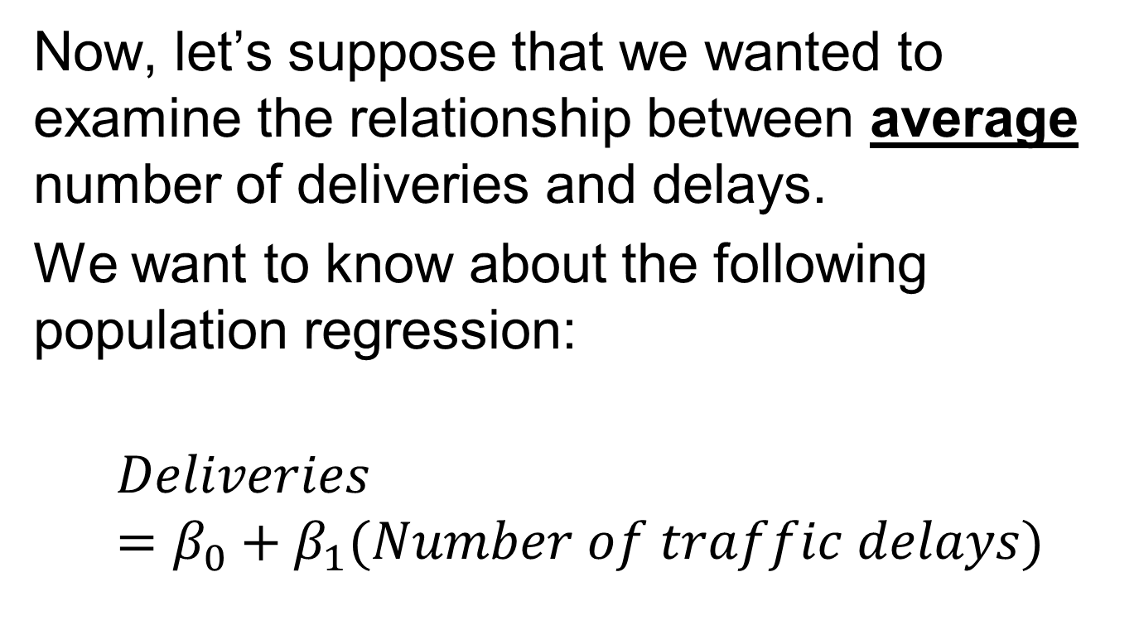
Case #1
Now, let’s suppose that we wanted to examine the relationship between average number of deliveries and delays.
We want to know about the following population regression:
$$Deliveries=β_{0}+β_{1}(Number of traffic delays)$$

Slide 40
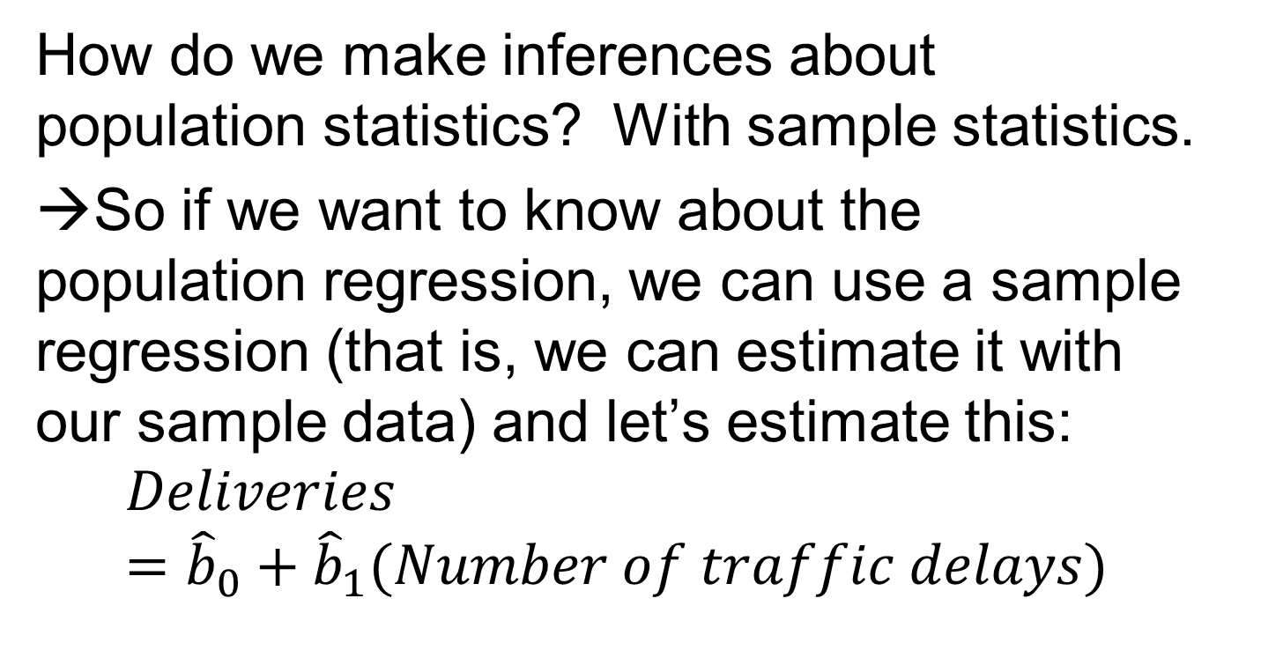
Case #1
How do we make inferences about population statistics? With sample statistics.
→So if we want to know about the population regression, we can use a sample regression (that is, we can estimate it with our sample data) and let’s estimate this:
$$Deliveries={\hat{b}}_{0}+{\hat{b}}_{1}(Number of traffic delays)$$

Slide 41
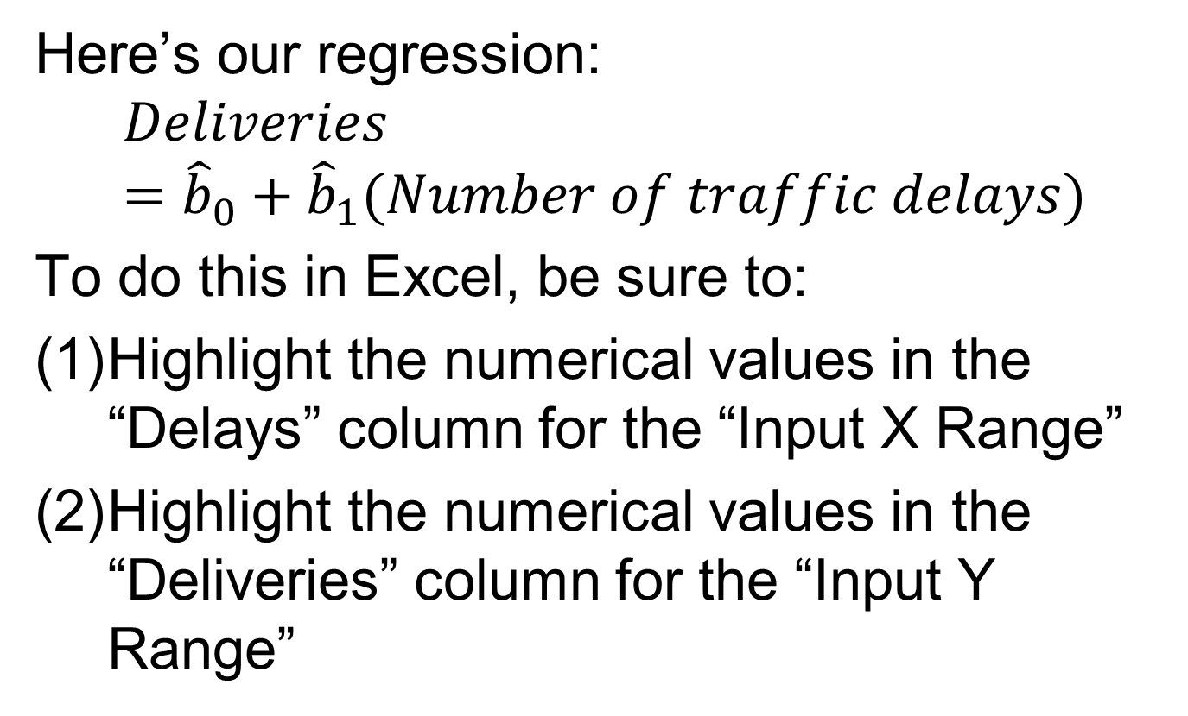
Case #1
Here’s our regression:
$$Deliveries={\hat{b}}_{0}+{\hat{b}}_{1}(Number of traffic delays)$$
To do this in Excel, be sure to:
Highlight the numerical values in the “Delays” column for the “Input X Range”
Highlight the numerical values in the “Deliveries” column for the “Input Y Range”

Slide 42
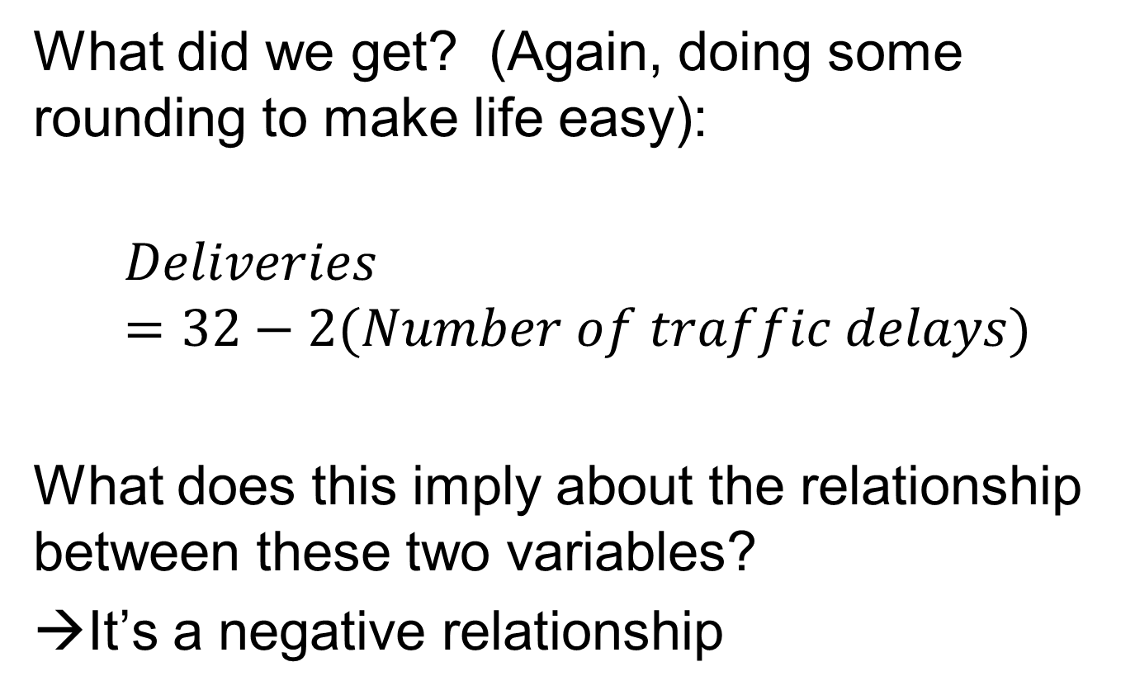
Case #1
What did we get? (Again, doing some rounding to make life easy):
$$Deliveries=32−2(Number of traffic delays)$$
What does this imply about the relationship between these two variables?
→It’s a negative relationship

Slide 43
Case #1
A formal way to examine this would be to test a hypothesis about the population relationship between delays and deliveries. How would we do this?
A popular approach focuses on the possibility of no relationship between these two variables.

Slide 44
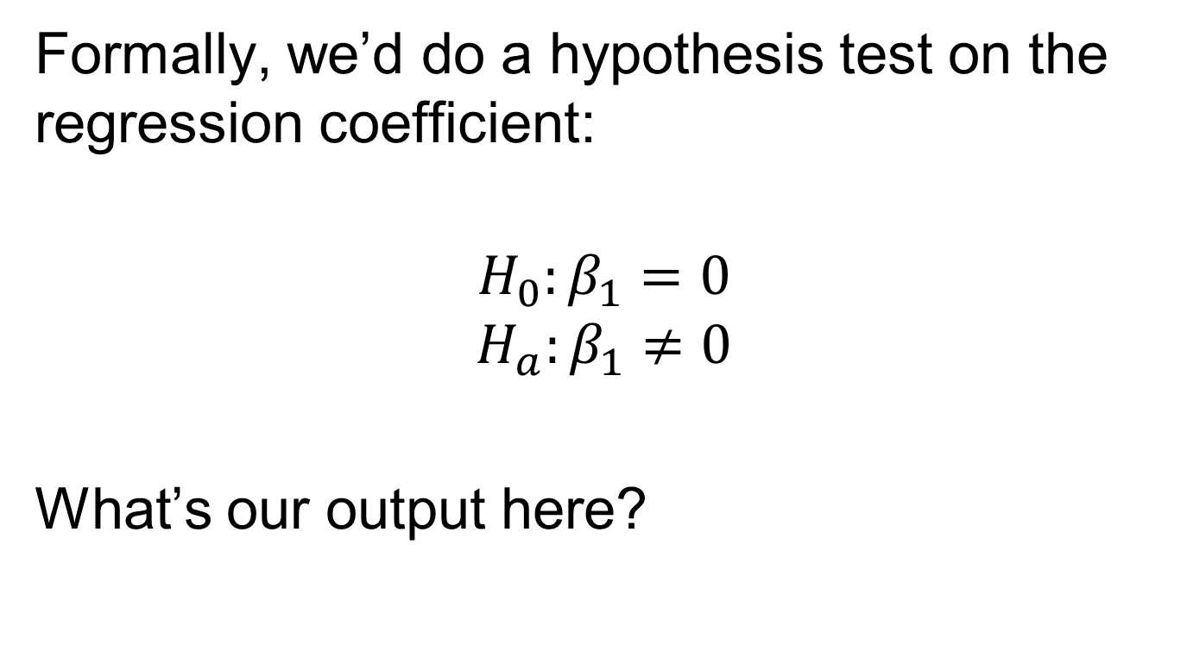
Case #1
Formally, we’d do a hypothesis test on the regression coefficient:
$$H_{0}:β_{1}=0$$
$$H_{a}:β_{1}≠0$$
What’s our output here?

Slide 45
Case #1
Regression Statistics
R Square | 0.9675
Standard Error | 0.7332
Observations | 400
ANOVA | df | SS
Regression | 1 | 6372.031
Residual | 398 | 213.9594
Total | 399 | 6585.99
 | Coefficients | Standard Error | t Stat
Intercept | 31.97969 | 0.073891 | 432.7962
X Variable 1 | -1.99563 | 0.01833 | -108.872

Slide 46
Case #1
Now, let’s make life easier and do some rounding of the key statistics

Slide 47
Case #1
Regression Statistics
R Square | 0.9675
Standard Error | 0.7
Observations | 400
ANOVA | df | SS
Regression | 1 | 6372.031
Residual | 398 | 213.9594
Total | 399 | 6585.99
 | Coefficients | Standard Error | t Stat
Intercept | 32 | 0.075 | 427
X Variable 1 | -2 | 0.02 | -100

Slide 48
Case #1
In this case, the absolute value of our test statistic is (much) larger than two, so we reject the null hypothesis that the coefficient is zero at the 5% level of significance.
What’s another way to say this?

Slide 49
Case #1
If the actual (population) relationship between delays and deliveries is zero in the population, the likelihood that we would have a sample regression coefficient like this is less than 5% (in fact, much less than 5%)
And let’s remind ourselves about the graphical representation of a regression line, too.

Slide 50
Case #1
Deliveries
If there are no delays, we should expect 32 deliveries
32
For every additional delay, we should see two fewer deliveries
–2
1
Delays

Slide 51
Case #2
Now, let’s suppose that UPS is considering the possibility of expanding into a new part of the city Toronto – a neighborhood called Leslieville.
And suppose that we know the following things about Leslieville:

Slide 52
Case #2
Specifically:
Revenue per delivery is $5
Traffic varies from day-to-day, but on average, there is one traffic delay each day in Leslieville.
It costs $100 to have a driver operate in that part of the city

Slide 53
Case #2
Now suppose that UPS management believes that such a driver would generate – on average – no profits. What is your response?
(And please don’t read ahead)

Slide 54
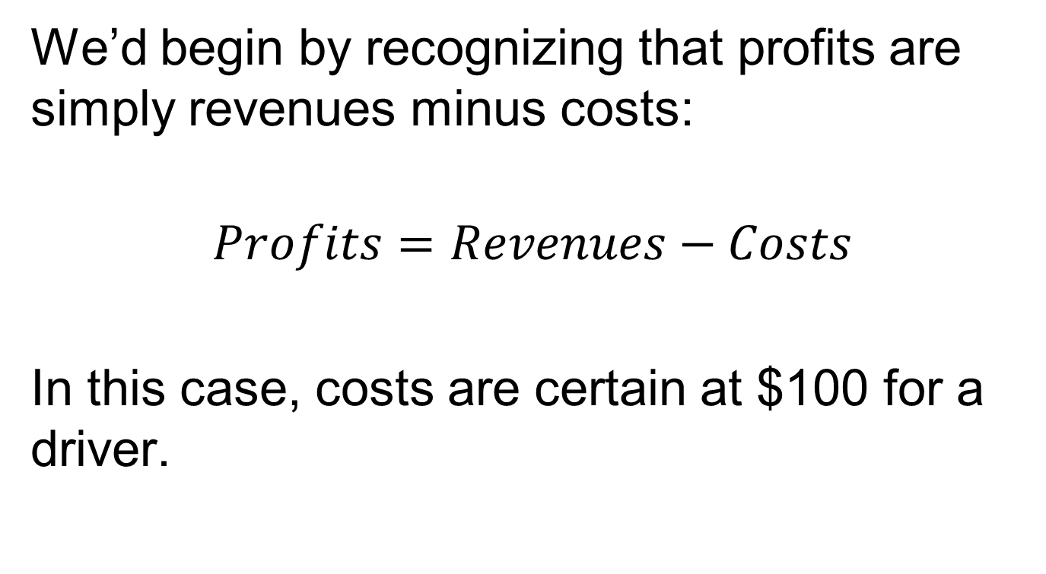
Case #2
We’d begin by recognizing that profits are simply revenues minus costs:
$$Profits=Revenues−Costs$$
In this case, costs are certain at $100 for a driver.

Slide 55
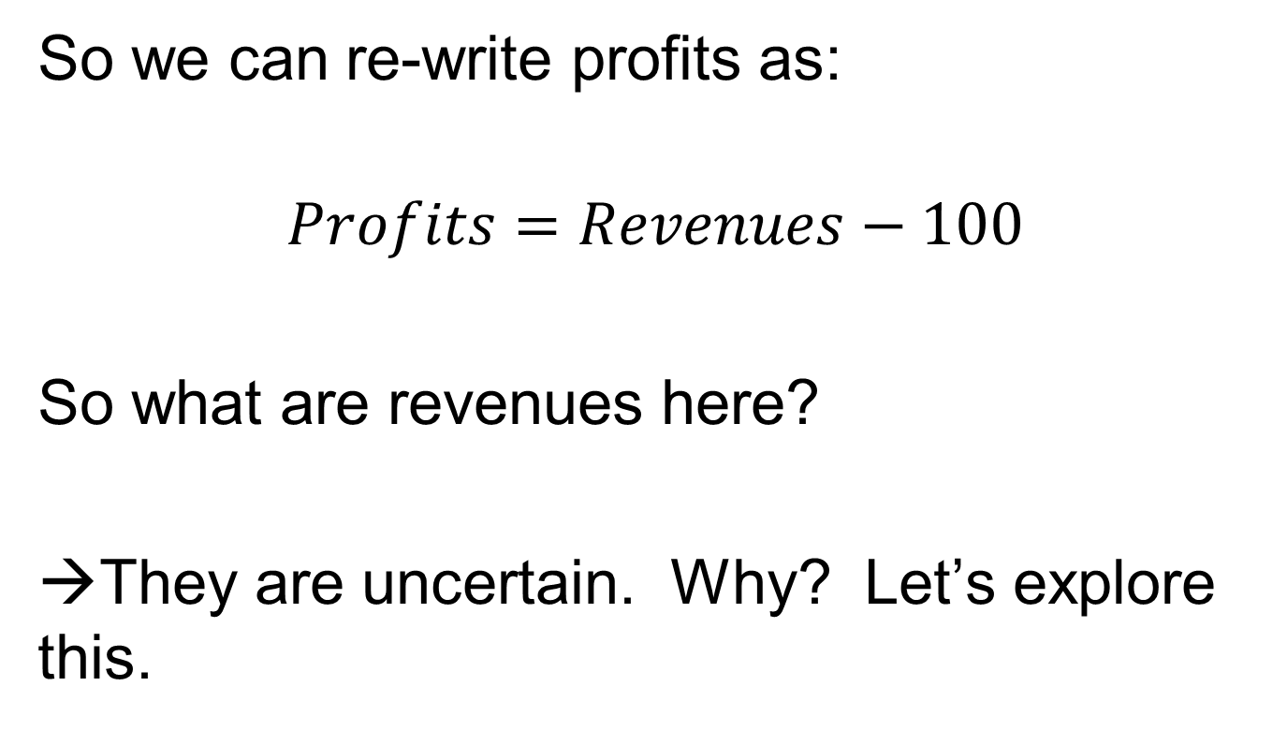
Case #2
So we can re-write profits as:
$$Profits=Revenues−100$$
So what are revenues here?
→They are uncertain. Why? Let’s explore this.

Slide 56
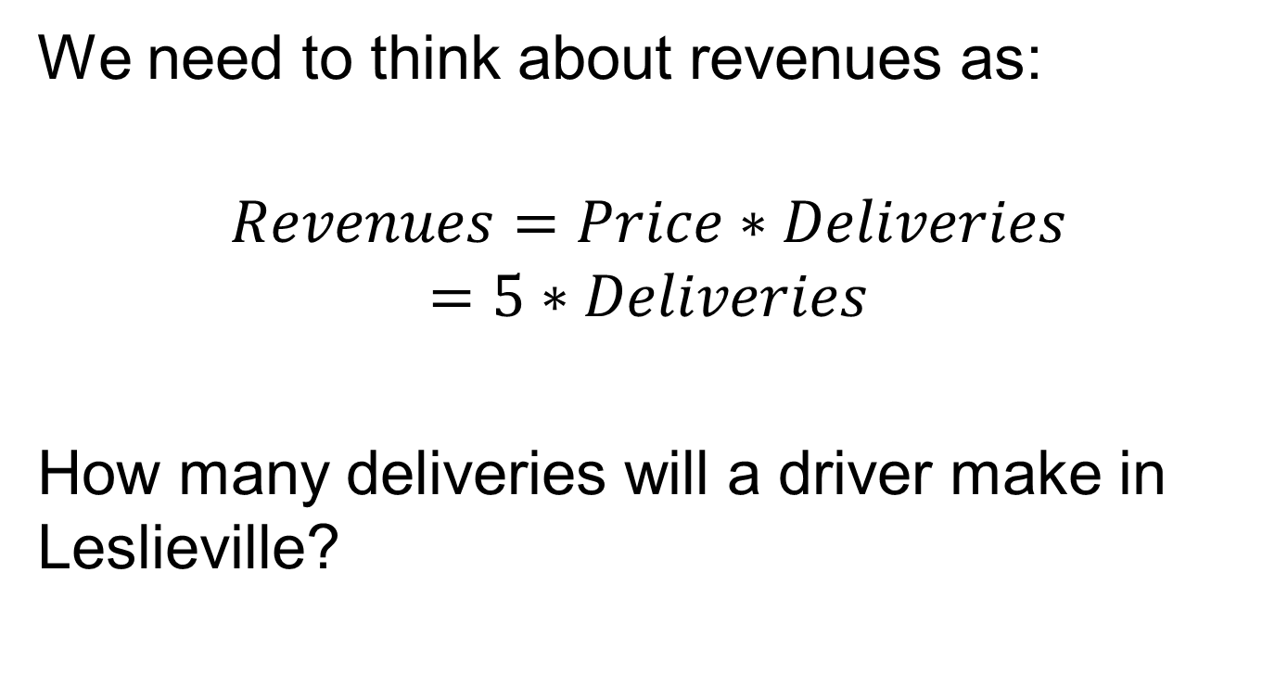
Case #2
We need to think about revenues as:
$$Revenues=Price∗Deliveries$$
$$=5∗Deliveries$$
How many deliveries will a driver make in Leslieville?

Slide 57
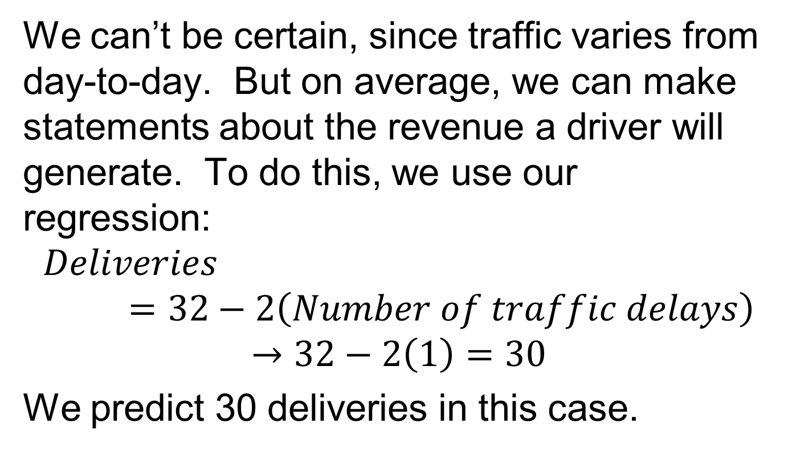
Case #2
We can’t be certain, since traffic varies from day-to-day. But on average, we can make statements about the revenue a driver will generate. To do this, we use our regression:
$$Deliveries=32−2\left(Number of traffic delays\right)$$
$$→32−2\left(1\right)=30$$
We predict 30 deliveries in this case.

Slide 58
Case #2
More technically, we’d say that our conditional mean for deliveries is 30 if there’s one traffic delay.
But this is a guess, so what’s our uncertainty around this guess?

Slide 59
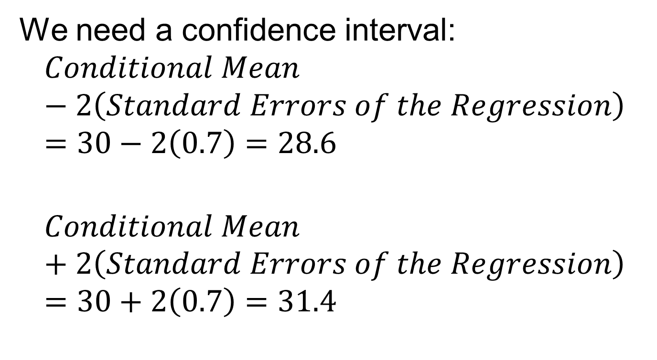
Case #2
We need a confidence interval:
$$Conditional Mean −2\left(Standard Errors of the Regression\right)=30−2\left(0.7\right)=28.6$$
$$Conditional Mean+2\left(Standard Errors of the Regression\right)=30+2\left(0.7\right)=31.4$$

Slide 60
Case #2
So we would expect that a Leslieville driver would have between 28.6 and 31.4 deliveries with 95% certainty.
And how much revenue would the driver create?

Slide 61
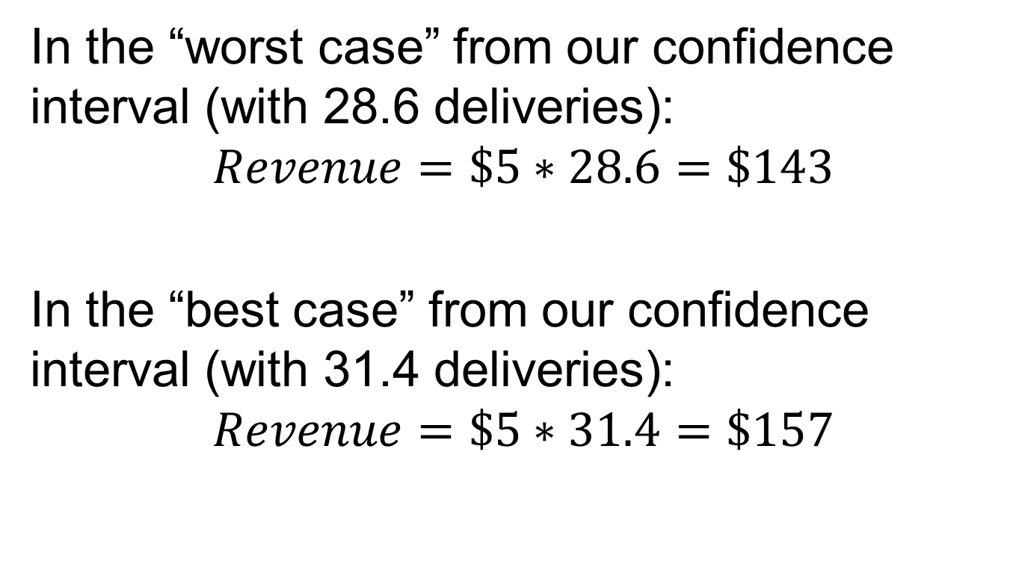
Case #2
In the “worst case” from our confidence interval (with 28.6 deliveries):
$$Revenue=\$5∗28.6=\$143$$
In the “best case” from our confidence interval (with 31.4 deliveries):
$$Revenue=\$5∗31.4=\$157$$

Slide 62
Case #2
And what would our 95% confidence interval for profits be in this case?
Between:
$143 - $100 = $43
$157 - $100 = $57

Slide 63
Case #2
So what is our response to management about moving into Leslieville?
We’re 95% sure that average profits there will be between $43 and $57 – and we would reject the idea that there would be zero average profits at the 5% level of significance.

Slide 64
Case #2
Or, how would we tie this back in to the CLT?
We’d say that the only way that the true level of profits in Leslieville was zero was if we happened to draw a very odd sample, which should happen with much less than a 5% probability.

Slide 65
Regression so far…
Up to this point, I have deliberately limited us to a discussion of “Bivariate Regressions”
→This is a fancy way of saying that we have analyzed regressions with one variable (Y) on the left hand side (called a “dependent” variable) and one variable (X) on the right hand side (called an “independent” variable)

Slide 66
Regression so far…
But of course, this is a very simplistic approach.
What we’d like to do is ask a more nuanced question: what is the effect of a given variable on some outcome, while controlling for other things?

Slide 67
…on to Multiple Regression (with some intuitive firepower)
But what does this mean?
This is really a movement towards a more detailed version of regression: Multiple Regression
Consider a really simple intuitive example to give you some intuitive “firepower” to deal with the technical aspects of this problem

Slide 68
Some intuitive firepower
Suppose that you were analyzing the prices of cakes, and you collected to following data:
What would we conclude about the relative prices of two-layer cakes relative to one-layer cakes?
One-Layer Cake | Two-Layer Cake
$10, $10, $10, $10, $10, $10 $16, $16 Average Price = $11.5 | $10, $10 $16, $16, $16, $16, $16, $16 Average Price = $14.5

Slide 69
Some intuitive firepower
We’d conclude that two-layer cakes can be sold for more, on average, than one-layer cakes (and this difference is about $3).
But now suppose that you not only got information about the number of layers on a cake, but also the amount of frosting on these cakes

Slide 70
Some intuitive firepower
Here’s the same data as before, but with the extra information about frosting:
Now, what would we conclude about the relative prices of one- and two-layer cakes?
 | One-Layer Cake | Two-Layer Cake
Two Cups of frosting | $16, $16 | $16, $16, $16, $16, $16, $16
One Cup of frosting | $10, $10, $10, $10, $10, $10 | $10, $10

Slide 71
Some intuitive firepower
We’d conclude that customers were equally willing to buy one- or two-layer cakes.
→But the key thing that changed prices was the amount of frosting! In fact, looking only at each type of batter, we see that using two cups of frosting raises prices by $6 compared to cakes that use only one cup of frosting!

Slide 72
Some intuitive firepower
More formally, we’d say:
Conditional on (or “holding constant”) the number of layers, we see cakes with two cups of frosting have higher prices than cakes with one cup of frosting
Conditional on (or “holding constant”) the amount of frosting, we see that one- and two-layer cakes have the same price

Slide 73
Some intuitive firepower
This is the intuitive idea behind our upcoming discussion. If we’re concerned about more than one factor being relevant to our analysis, then:
We may make inaccurate inferences from simple bivariate regressions, and
We need to ask what the impact of each factor is, while looking within (or holding constant) the other factor(s).

Slide 74
Data time
Let’s try this out for ourselves. Load cakes.xls onto your machines, and let’s do a few exercises. First, let’s be aware of the average prices in our data:
One-Layer Cake | Two-Layer Cake
Average Price = $11.4 | Average Price = $14.5

Slide 75
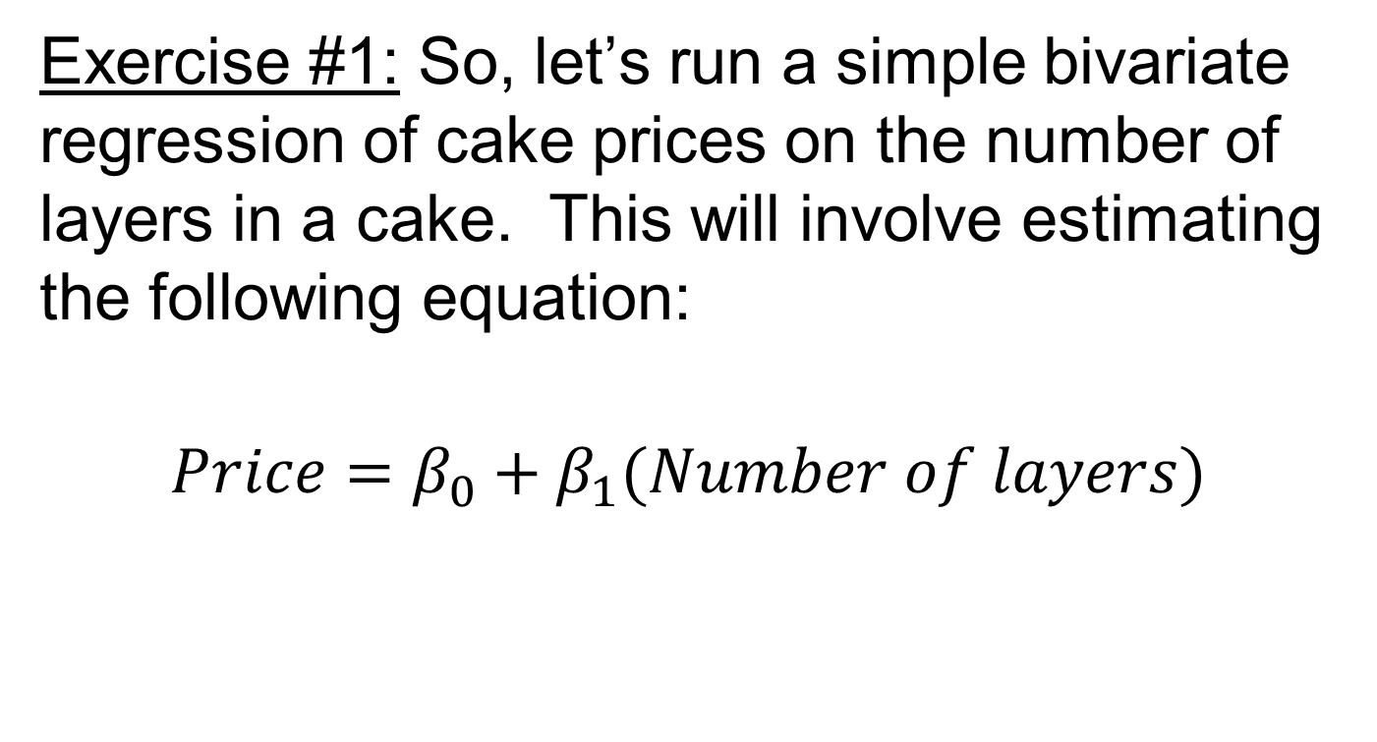
Data time
Exercise #1: So, let’s run a simple bivariate regression of cake prices on the number of layers in a cake. This will involve estimating the following equation:
$$Price=β_{0}+β_{1}(Number of layers)$$

Slide 76
Data time
Here’s what I found with my output:
Note: this is about what we’d expect – adding a layer increases the price by $3 (which explains the coefficient on “Layers”)
 | Coefficient | Std Error | T-stat
Intercept | 8.25 | 1.32 | 6.25
Layers | 3.11 | 0.84 | 3.72

Slide 77
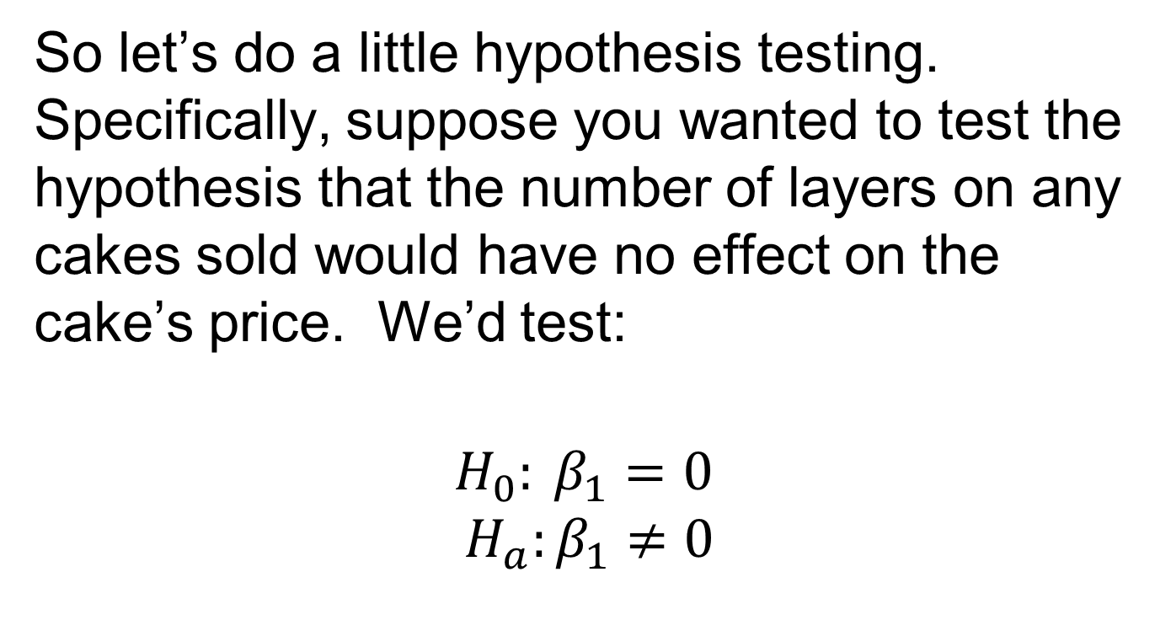
Data time
So let’s do a little hypothesis testing. Specifically, suppose you wanted to test the hypothesis that the number of layers on any cakes sold would have no effect on the cake’s price. We’d test:
$$H_{0}: β_{1}=0$$
$$H_{a}:β_{1}≠0$$

Slide 78
Data time
What do we find?
Using a t-test approach (but we could have also done this with confidence intervals): Note that the absolute value of the t-statistic on this coefficient is greater than 2. So we say “We reject the null hypothesis at the 5% level of significance”. What does this mean?

Slide 79
Data time
It means that, based on our sample evidence, we dismiss the idea that the number of layers on a cake has no impact on its price. (Or in plain English, it appears that layers are positively related to cake prices).

Slide 80
Data time
Exercise #2: Now, for comparison, let’s start to examine how the average prices of the cakes in our data depend both on their number of layers and their amount of frosting

Slide 81
Data time
Exercise #2:
Here’s a quick description of the key averages that we need to know:
So this looks a lot like our earlier table
 | One-Layer Cake | Two-Layer Cake
Two Cups of frosting | Average price = $15.7 | Average price = $16
One Cup of frosting | Average price = $9.9 | Average price = $10

Slide 82
Data time
Given what we’ve found, we’d like to determine the way in which cake prices change because of changes in BOTH layers and frosting. But how do we do this?
We use what’s called a “Multiple Regression” (which is just a fancy term for using more than just one variable on the right-hand side of the regression)

Slide 83
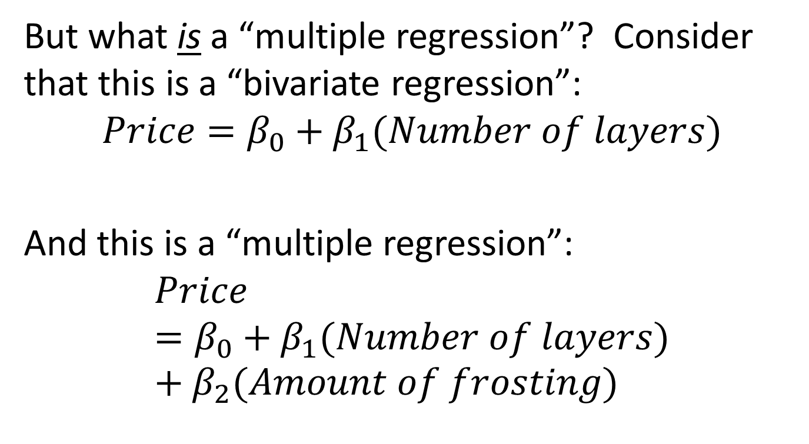
Data time
But what is a “multiple regression”? Consider that this is a “bivariate regression”:
$$Price=β_{0}+β_{1}(Number of layers)$$
And this is a “multiple regression”:
$$Price=β_{0}+β_{1}(Number of layers)+β_{2}(Amount of frosting)$$

Slide 84
Intuitive problem
OK, but when we include more than one independent variable in our regression, what do the coefficients mean?
Before, when we just included one independent variable, it was clear how to intuitively interpret the estimated value of the coefficient.

Slide 85
Reminder
Any straight line can be described with an equation: Y = mX + b
Key concepts:
“b” is the intercept
“m” is the slope of the line, where
m = slope = ΔY/ΔX = “rise”/“run”

Slide 86
Y
b
ΔY=m
ΔX=1
X

Slide 87
But what’s going on when we have two independent variables?
We’re not estimating a line anymore, but there is still an intuitive interpretation for a multiple regression coefficient

Slide 88
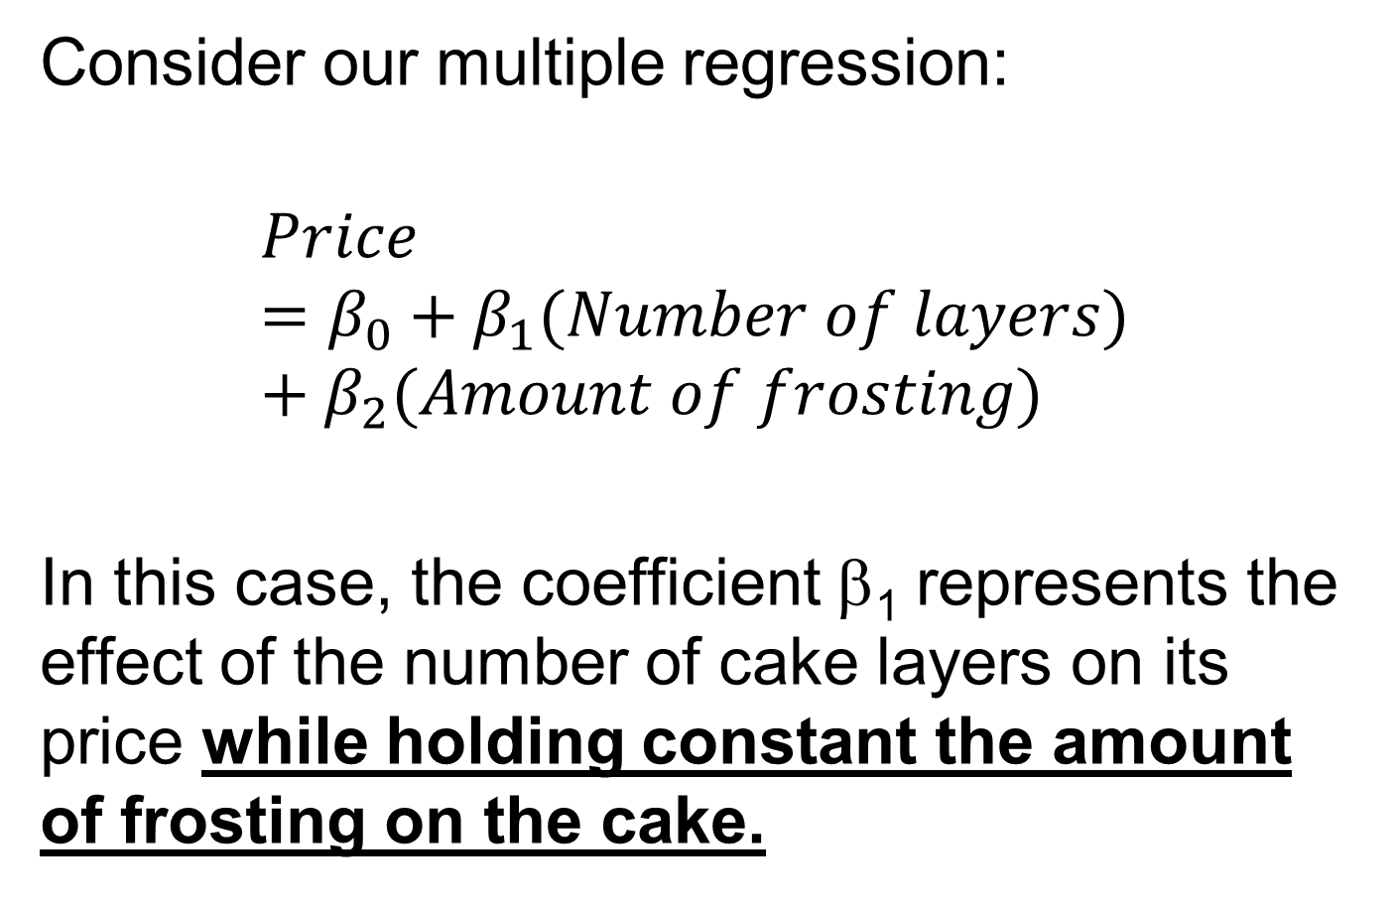
Consider our multiple regression:
$$Price=β_{0}+β_{1}(Number of layers)+β_{2}(Amount of frosting)$$
In this case, the coefficient β₁ represents the effect of the number of cake layers on its price while holding constant the amount of frosting on the cake.

Slide 89
So you can still have the picture of the line in your head when you think about a multiple regression coefficient.
Only now, you need to remember that the slope of the line represents the effect of the particular variable on Y while holding constant all the other “X” variables in our regression.

Slide 90
There’s also another way to think about this, but it’s technical, so…

Slide 91
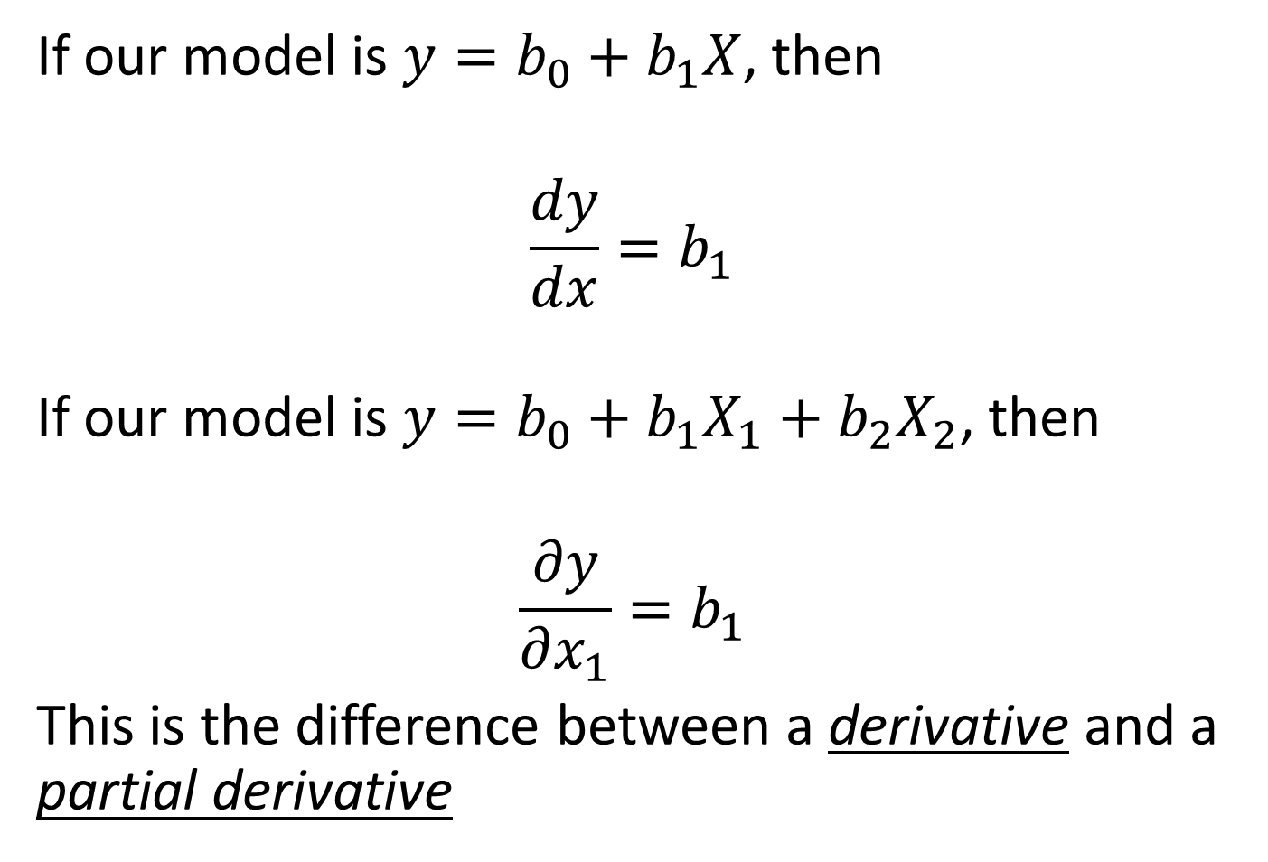
If our model is $y=b_{0}+b_{1}X$, then
$$\frac{dy}{dx}=b_{1}$$
If our model is $y=b_{0}+b_{1}X_{1}+b_{2}X_{2}$, then
$$\frac{∂y}{∂x_{1}}=b_{1}$$
This is the difference between a derivative and a partial derivative

Slide 92
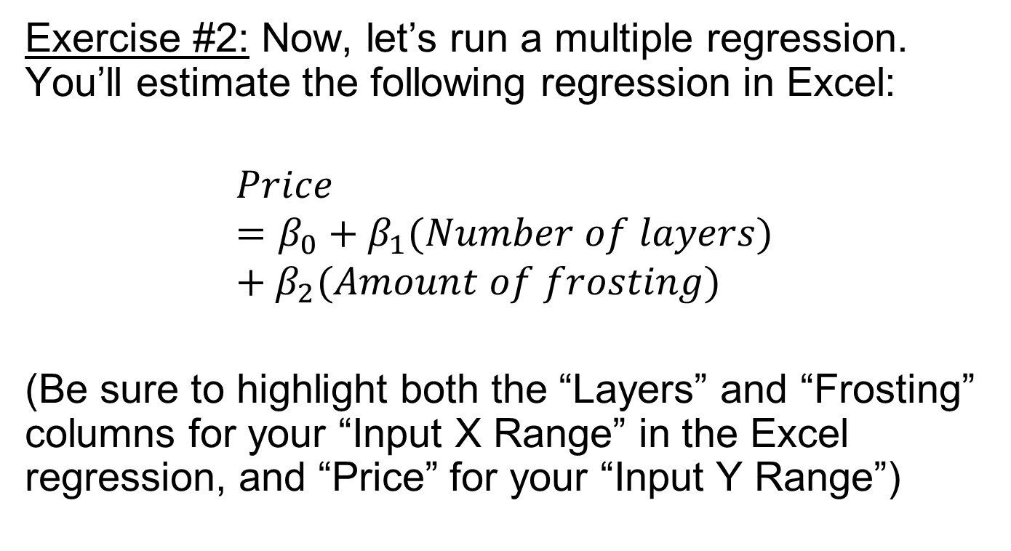
Data time
Exercise #2: Now, let’s run a multiple regression. You’ll estimate the following regression in Excel:
$$Price=β_{0}+β_{1}(Number of layers)+β_{2}(Amount of frosting)$$
(Be sure to highlight both the “Layers” and “Frosting” columns for your “Input X Range” in the Excel regression, and “Price” for your “Input Y Range”)

Slide 93
Data time
Here’s what I got:
So what does this tell us?
 | Coefficient | Std Error | T-stat
Intercept | 3.84 | 0.84 | 4.5
Layers | 0.17 | 0.54 | 0.3
Frosting | 5.88 | 0.54 | 10.8

Slide 94
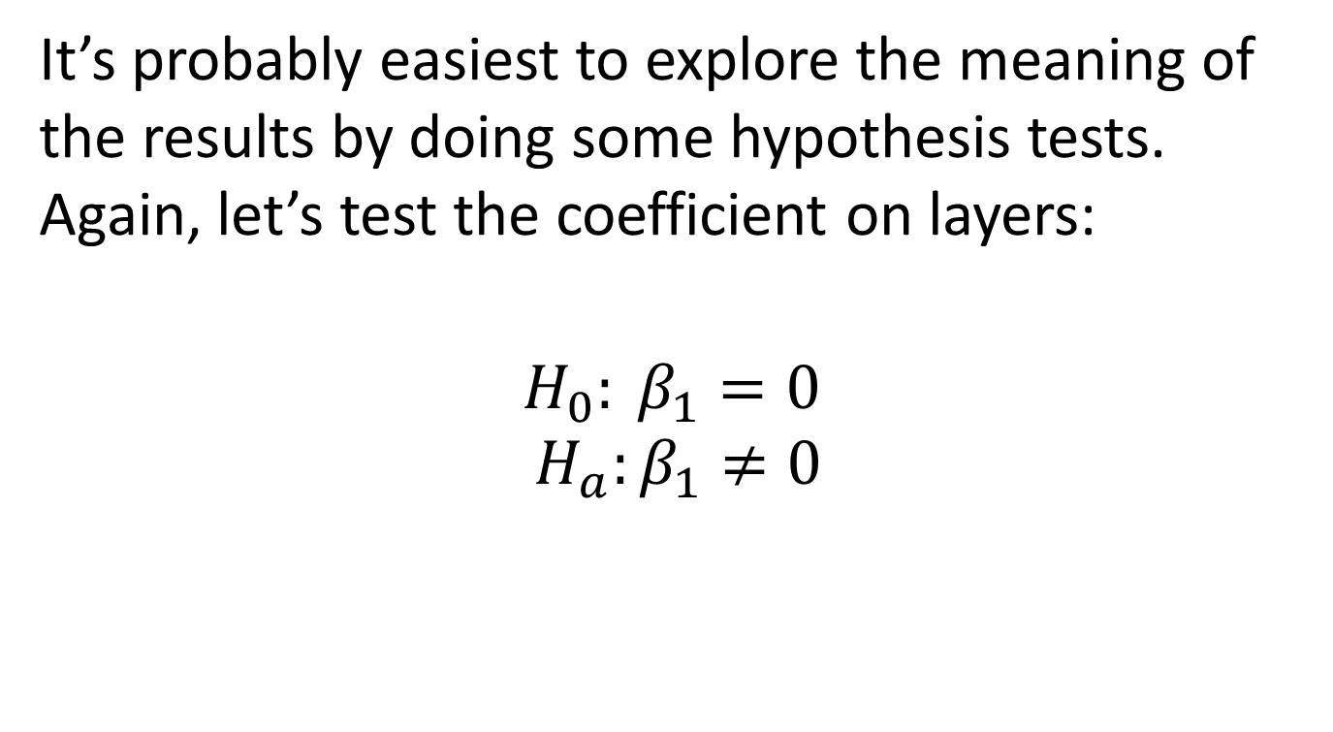
Data time
It’s probably easiest to explore the meaning of the results by doing some hypothesis tests. Again, let’s test the coefficient on layers:
$$H_{0}: β_{1}=0$$
$$H_{a}:β_{1}≠0$$

Slide 95
Data time
What’s the result of our hypothesis test?
Here, note that the t-statistic is less than two in absolute value, so we fail to reject the null at the 5% level of significance. What does this mean?

Slide 96
Data time
It means that – holding constant the amount of frosting on a cake – we can’t reject the idea that the number of layers on a cake has no effect on its price.

Slide 97

Data time
Now, let’s test the coefficient on frosting:
$$H_{0}: β_{2}=0$$
$$H_{a}:β_{2}≠0$$
What do we see?

Slide 98
Data time
We note that here, the t-statistic is 10.8, so we can reject (at the 5% level of significance) the hypothesis that frosting has no effect on a cake’s price.

Slide 99
One last thing…
Intuitively, why did the coefficient on layers change once we included the variable capturing the amount of frosting? (That is, once we moved from a bivariate to a multivariate regression)
→Remember what regression does: it tells you when two variables are correlated. Here, in the bivariate case, prices were correlated with layers.

Slide 100
One last thing…
But why were these two variables correlated? Because cakes with two layers were more likely to have two cups of frosting than cakes with only one layer.
Further, because frosting increases cake prices, the number of cake layers captured this effect when we omitted frosting from the regression.

Slide 101
Altering the example
Okay, but could we conceive of a different case where BOTH frosting AND layers had an effect on prices?
Sure – it would look like this:

Slide 102
Altering the example
Note that, CONDITIONAL ON HOLDING THE OTHER VARIABLE CONSTANT, both factors increase the price of the cake.
 | One-Layer Cake | Two-Layer Cake
Two Cups of frosting | Average price = $16 | Average price = $20
One Cup of frosting | Average price = $10 | Average price = $14

Slide 103
Altering the example
Note that:
An extra cup of frosting increases the price by $6 while holding constant the number of layers.
And an extra layer of cake increases the price by $4 while holding constant the amount of frosting.

Slide 104
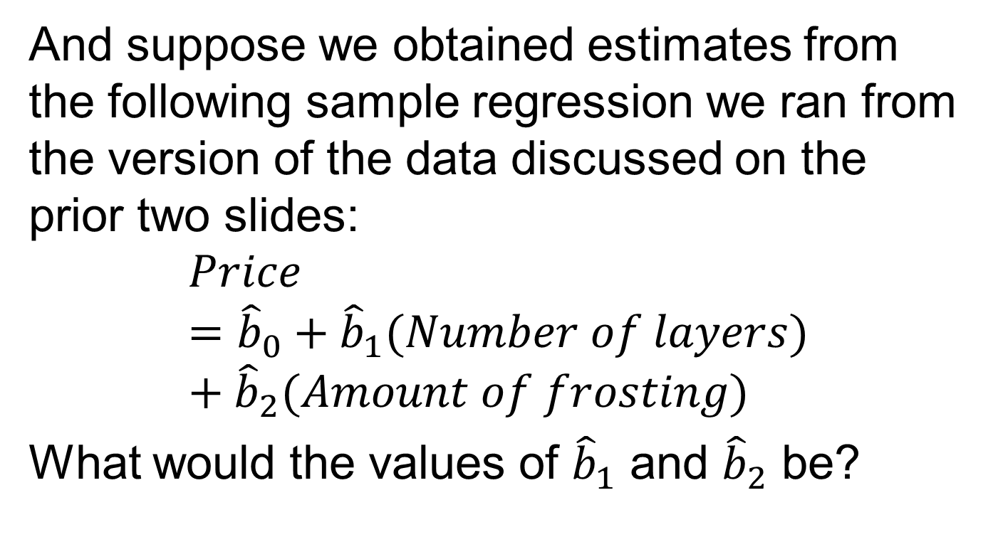
Altering the example
And suppose we obtained estimates from the following sample regression we ran from the version of the data discussed on the prior two slides:
$$Price={\hat{b}}_{0}+{\hat{b}}_{1}(Number of layers)+{\hat{b}}_{2}(Amount of frosting)$$
What would the values of ${\hat{b}}_{1}$ and ${\hat{b}}_{2}$ be?

Slide 105
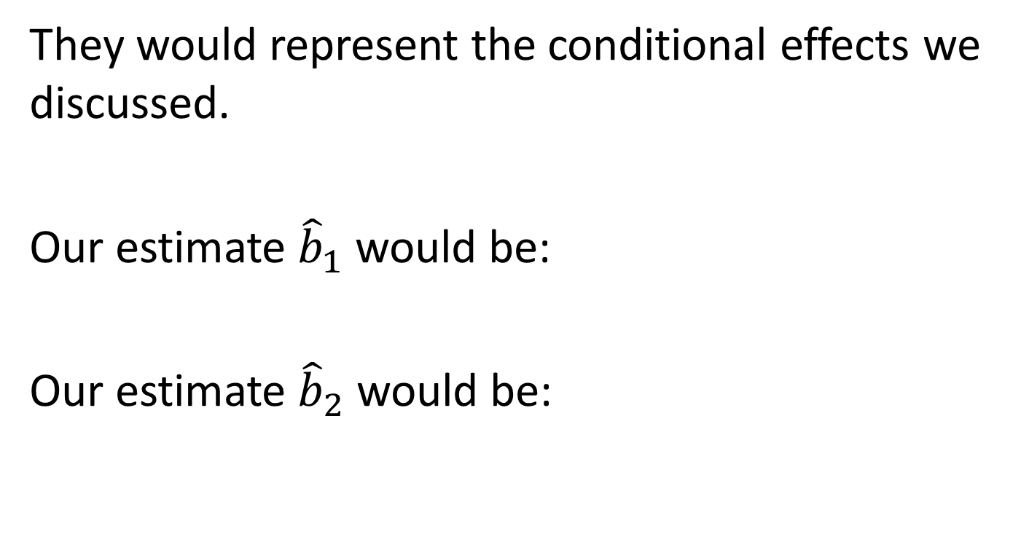
Altering the example
They would represent the conditional effects we discussed.
Our estimate ${\hat{b}}_{1}$ would be:
Our estimate ${\hat{b}}_{2}$ would be:
4
6

Slide 106
The larger point
This is why we often say that correlation does not imply causation: it’s because we worry about regressions omitting variables. Sometimes we omit variables by accident, and sometimes we omit variables because we can’t get information on relevant issues. And if that’s the case, then we worry about getting the coefficient wrong (as we did in this case).

Slide 107
The larger point
And when we get an inappropriate estimate for a coefficient, we say that it’s “biased”. And when this bias occurs because we’ve omitted a variable, we have a particular name for it:
Omitted Variable Bias (or OVB, for short)

Slide 108
The larger point
OVB is the bane of all statistical work, and we want to be critically aware of this as we move through the course.
Why?
Because I want you to become critical consumers of statistics provided to you, and OVB should always be foremost in your mind.

